Slide 1
(Algorithm) Analysis

Slide 2
Algorithm Efficiency
There are often many approaches (algorithms) to solve a problem. How do we choose between them?
At the heart of computer program design are two (sometimes conflicting) goals.
To design an algorithm that is easy to understand, code, debug.
To design an algorithm that makes efficient use of the computer’s resources.

Slide 3
Algorithm Efficiency (cont)
Goal (1) is the concern of Software Engineering.
Goal (2) is the concern of data structures and algorithm analysis.
When goal (2) is important, how do we measure an algorithm’s cost?

Slide 4
How to Measure Efficiency?
Empirical comparison (run programs)
Asymptotic Algorithm Analysis
Notes:
Empirical comparison is difficult to do “fairly” and is time consuming.
Critical resources: Time. Space (disk, RAM). Programmers effort. Ease of use (user’s effort).
Factors affecting running time: Machine load. OS. Compiler. Problem size. Specific input values for given problem size.

Slide 5
How to Measure Efficiency?
Empirical comparison (run programs) is not satisfactory. Why?
First, there is the effort involved in programming and testing two algorithms when at best you want to keep only one.
Second, when empirically comparing two algorithms there is always the chance that one of the programs was “better written”.
Third, the choice of empirical test cases might unfairly favor one algorithm.
Fourth, you could find that even the better of the two algorithms does not fall within your resource budget.
Notes:
Empirical comparison is difficult to do “fairly” and is time consuming.
Critical resources: Time. Space (disk, RAM). Programmers effort. Ease of use (user’s effort).
Factors affecting running time: Machine load. OS. Compiler. Problem size. Specific input values for given problem size.

Slide 6
How to Measure Efficiency?
Empirical comparison (run programs)
Asymptotic Algorithm Analysis
So we need to consider the second option.
Notes:
Empirical comparison is difficult to do “fairly” and is time consuming.
Critical resources: Time. Space (disk, RAM). Programmers effort. Ease of use (user’s effort).
Factors affecting running time: Machine load. OS. Compiler. Problem size. Specific input values for given problem size.

Slide 7
How to Measure Efficiency?
Asymptotic Algorithm Analysis
Critical resources: Running time and Space
For most algorithms, running time depends on “size” of the input.
We estimate the number of “basic operations” required by the algorithm to process an input of a certain “size”.
Running time is expressed as T(n) for some function T on input size n.
Notes:
Empirical comparison is difficult to do “fairly” and is time consuming.
Critical resources: Time. Space (disk, RAM). Programmers effort. Ease of use (user’s effort).
Factors affecting running time: Machine load. OS. Compiler. Problem size. Specific input values for given problem size.

Slide 8
Examples of Growth Rate
Example 1.
/** @return Position of largest value in "A“ */
static int largest(int[] A) {
int currlarge = 0; // Position of largest
for (int i=1; i<A.length; i++)
if (A[currlarge] < A[i])
currlarge = i; // Remember pos
return currlarge; // Return largest pos
}
Notes:
As n grows, how does T(n) grow?
Cost: T(n) = c₁n + c₂ steps

Slide 9
Examples of Growth Rate
Example 1.
/** @return Position of largest value in "A“ */
static int largest(int[] A) {
int currlarge = 0; // Position of largest
for (int i=1; i<A.length; i++)
if (A[currlarge] < A[i])
currlarge = i; // Remember pos
return currlarge; // Return largest pos
}
We can deduce: T(n) = cn
c is a constant in the sense that it is not dependent on n
Notes:
As n grows, how does T(n) grow?
Cost: T(n) = c₁n + c₂ steps

Slide 10
Examples (cont)
Example 2: Assignment statement.
We can say: T(n) = c_1
Example 3:
sum = 0;
for (i=1; i<=n; i++)
for (j=1; j<n; j++)
sum++;
}
We can deduce: T(n) = c_2 n^2.
We can ignore initializations or can assume these to be included within c_2
Increment/comparison of loop counters can be assumed to be included in c_2
Notes:
Example 2: Constant cost.
Example 3: Cost: T(n) = c₁n² + c². Roughly n² steps, with sum being n² at the end. Ignore various overhead such as loop counter increments.

Slide 11
Growth Rate
In essence we are interested in the growth rate of a algorithm
Growth rate for an algorithm is the rate at which the cost of the algorithm grows as the size of its input grows.

Slide 12
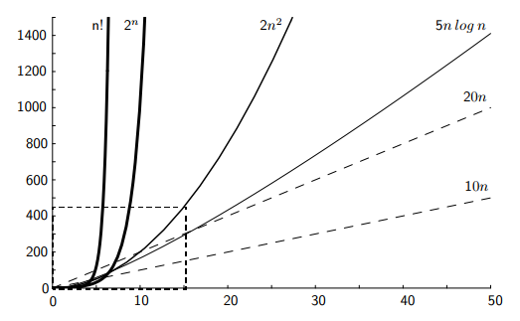
Growth Rate Graph

Slide 13
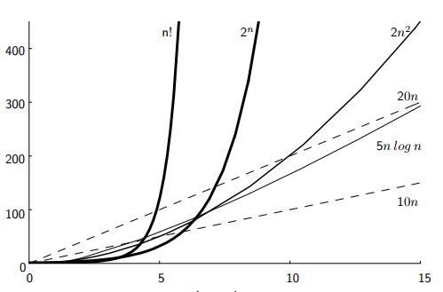
Growth Rate Graph

Slide 14
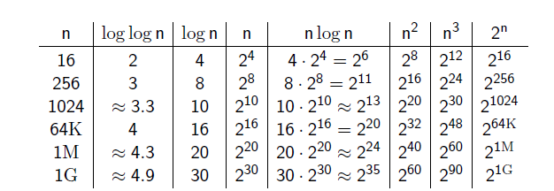
Growth Rate Table

Slide 15
Best, Worst, Average Cases
largest() always examines every array value.
This algorithm works on many inputs of a given size n.
no matter what array of size n that the algorithm looks at, its cost will always be the same
/** @return Position of largest value in "A“ */
static int largest(int[] A) {
int currlarge = 0; // Position of largest
for (int i=1; i<A.length; i++)
if (A[currlarge] < A[i])
currlarge = i; // Remember pos
return currlarge; // Return largest pos
}
Notes:
Best: Find at first position. Cost is 1 compare.
Worst: Find at last position. Cost is n compares.
Average: (n+1)/2 compares IF we assume the element with value K is equally likely to be in any position in the array.

Slide 16
Best, Worst, Average Cases
Consider a slightly different problem but a similar algorithm:
Search for K in an array of n integers:
Sequential Search Algorithm: Begin at first element in array and look at each element in turn until K is found (assume K appears only once for now)
Not all inputs of a given size will take the same time to run now.
Unlike large()
Now the question comes, what are the Best, Worst and Average cases?
Notes:
Best: Find at first position. Cost is 1 compare.
Worst: Find at last position. Cost is n compares.
Average: (n+1)/2 compares IF we assume the element with value K is equally likely to be in any position in the array.

Slide 17
Best, Worst, Average Cases
Sequential Search Algorithm: Begin at first element in array and look at each element in turn until K is found (assume K appears only once for now)
Best case: T(n) = c
Worst case: T(n) = cn
Average case: T(n) = c n/2
When the first element is in fact K
When the last element is K or it is absent.
run it many times on many different arrays of size n,
or search for many different values of K within the same array,
=> On average, the algorithm examines about n/2 values.
Notes:
Best: Find at first position. Cost is 1 compare.
Worst: Find at last position. Cost is n compares.
Average: (n+1)/2 compares IF we assume the element with value K is equally likely to be in any position in the array.

Slide 18
Which Analysis to Use?
While average time appears to be the fairest measure, it may be difficult to determine.
For real-time application, the worst case time is the most important.
Notes:
Average time analysis requires knowledge of distributions. For example, the assumption of distribution used for average case in the last example.
Worst-case time is important for real-time algorithms.

Slide 19
Faster Computer or Faster Algorithm
If the algorithm’s growth rate is greater than cn, such as c1n^2, then you will not be able to do a problem ten times the size in the same amount of time on a machine that is ten times faster.
Old PC can do 10K basic operations/s
New PC is 10x faster (i.e., 100K basic ops/s)
N (N’)=max input size can be handled in a sec in old (new) PC
f(n) | Calculate N | N | Calculate N’ | N’ | N’/N
10n | 10n = 10000 | 1000 | 10n = 100000 | 10000 | 10
20n | 20n=10000 | 500 | 20n = 100000 | 5000 | 10
5n log n | 5n log n=10000 | 250 | 5n log n = 100000 | 1842 | 7.368
2n^2 | 2n^2=10000 | 70.71068 | 2n^2 =100000 | 223.6068 | 3.162278
3n^2 | 3n^2=10000 | 57.73503 | 3n^2 =100000 | 182.5742 | 3.162278
4n^2 | 4n^2=10000 | 50 | 4n^2 =100000 | 158.1139 | 3.162278
4n^3 | 4n^3=10000 | 13.57209 | 4n^3 =100000 | 29.24018 | 2.154435
2^n | 2^n=10000 | 13.28771 | 2^n = 100000 | 16.60964 | 1.25
3^n | 3^n=10000 | 8.383613 | 3^n = 100000 | 10.47952 | 1.25
4^n | 4^n=10000 | 6.643856 | 4^n = 100000 | 8.30482 | 1.25
N’ ≈ 10N
Constant factors never affect the relative improvement gained by a faster computer; it only affect the absolute size.
N’ ≈ √10N
N’ ≈ 10^{1/3}N
For a machine 100x faster
N’ ≈ N + log_2 10
N’ ≈ N + log_2 100 = 19.93
N’ ≈ N + log_3 10
N’ ≈ N + log_3 100 = 12.58
N’ ≈ N + log_4 10
N’ ≈ N + log_4 100 = 9.97

